Slide 1
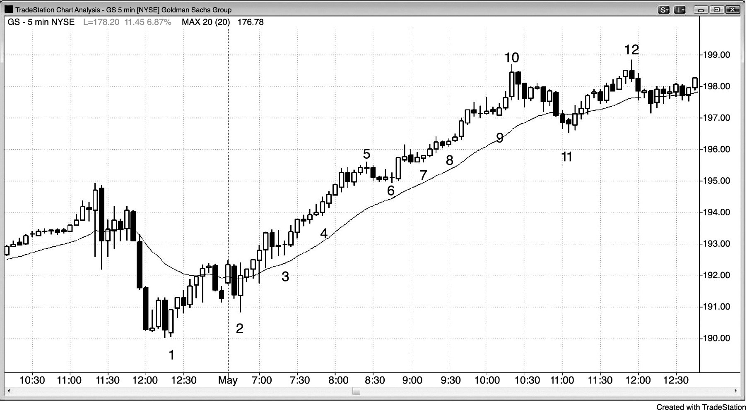
FIGURE 11.1 Consecutive Trend Bars in a Trend

